Slide 1

The Establishment of the Luminosity Function for Brown Dwarf Candidates In GAIA Early Data Release 3
Dylan Hilligoss
Masters Thesis in Physics
University of Delaware
Advisor: Prof. J. Gizis
Department of Physics and Astronomy
University of Delaware

Slide 2
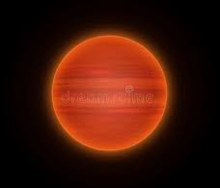

Objectives of this Thesis
Brown Dwarf History/Physics
GAIA
Mission
Luminosity Function
Comparison to Theoretical Models
Notes:
Brown dwarf physics and observational history
GAIA mission and how its data can be manipulated to create a local luminosity function
Compare the observational luminosity function to current models for context

Slide 3
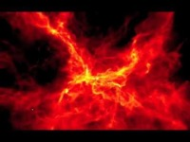
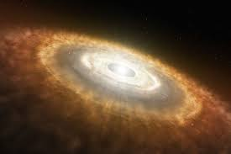
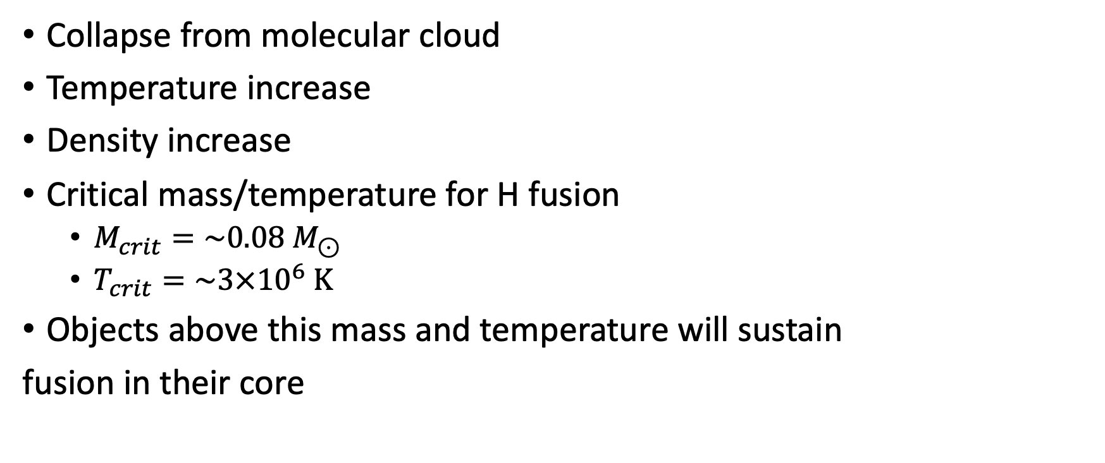
Main Sequence Stars
Collapse from molecular cloud
Temperature increase
Density increase
Critical mass/temperature for H fusion
$M_{crit}=\sim 0.08{ M}_{⊙}$
$T_{crit}=\sim 3×{10}^{6} K$
Objects above this mass and temperature will sustain
fusion in their core
Source: http://www.astro.ex.ac.uk/people/mbat...
Notes:
First start by briefly describing how MS stars form.
Regions of higher density gravitationally collapse to eventually form stars
Stars reach critical mass and temperature prior to becoming fully degenerate (electron)

Slide 4
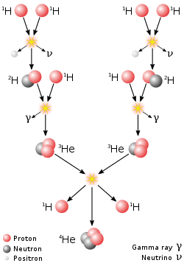
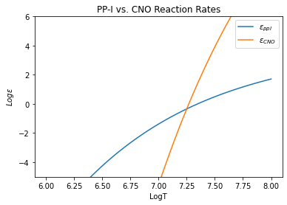
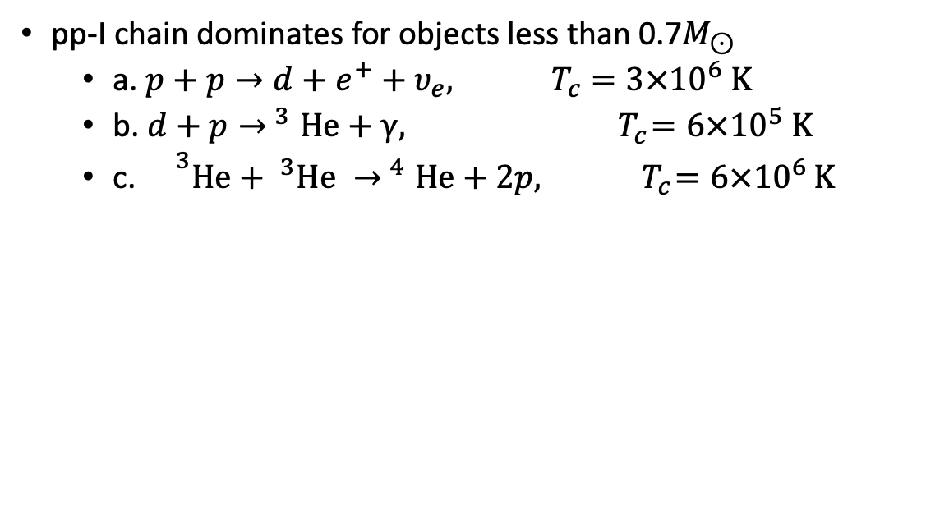
Nuclear Fusion
pp-I chain dominates for objects less than 0.7$M_{⊙}$
a. $p+p→d+e^{+}+υ_{e}, { T}_{c}=3×{10}^{6} K$
b. $d+p{→ }^{3}He+γ, { T}_{c}=6×{10}^{5} K$
c. ${}^{3}He+ ^{3}He {→ }^{4}He+2p, { T}_{c}=6×{10}^{6 }K$
Source: Wikipedia
Notes:
Stars like the sun and less massive predominately get their energy from the pp-I nuclear fusion chain
CNO cycle dominates energy production for stars 1.3 more massive than the Sun
First stage of pp1 takes ~9 billion years due to being initiated by the weak nuclear force (beta decay)
Second stage occurs very quickly. Deuterium in sun only lasts for ~1 second before fusing to become a helium isotope (due to mediation by strong nuclear force)
Net energy of pp1 chain in ~26.7MeV – energy carried away by the neutrinos

Slide 5
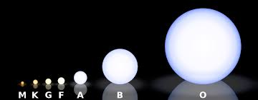
But what about objects below spectral type M stars?
Notes:
These nuclear reactions (pp chain, CNO) lead to the creation of MS stars ranging in mass, size, brightness, and temperature from spectral type O stars to spectral type M stars.
But what about objects that fall below M type stars?

Slide 6
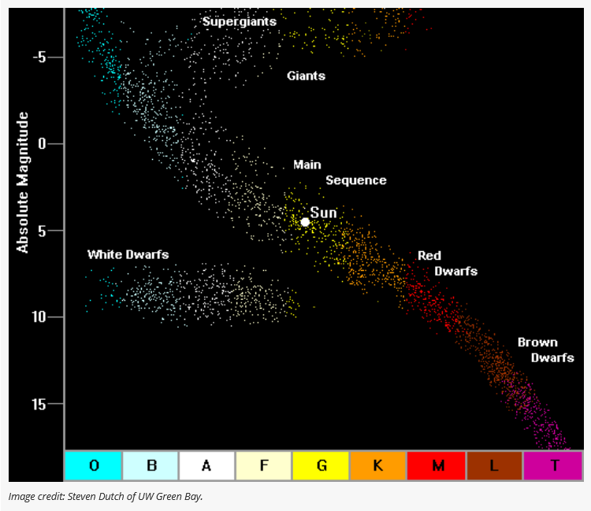
Brown Dwarfs 101
First proposed in the 1960s by Shiv Kumar
Fill the missing mass gap between the
least massive stars and most massive planets
Failed “stars”
Does not reach critical mass/hydrogen burning minimum mass (HBMM)
Becomes degenerate prior to reaching HBMM and critical ignition temperature
Fuses deuterium and lithium rather than hydrogen
Some even cool enough to have complex, molecular atmospheres
Notes:
Shiv Kumar proposed the existence of “black dwarfs” later coined “brown dwarfs” by Jill Tarter in 1975 to account for the missing mass gap between the least massive stars and most massive planets
Least massive stars are about 8% the mass of the sun (80x the mass of Jupiter) while the most massive planets are at about 13x the mass of Jupiter
Brown dwarfs initially thought to be a solution to the “dark matter problem” at the time. Quickly ruled out as a solution because studying galactic motion and microlensing suggests that dark matter is approximately 30% the density of the universe. Abundances of hydrogen, deuterium and lithium and other primordial elements from the big bang only make up 5% of the density of the universe
Essentially ”failed stars”
Cloud collapses increasing core temperature and core density
Density increases enough to make the electrons degenerate
Degeneracy acts as an energy sink curbing the rise of the core temperature
HSE is achieved and collapse halts when the sum of gas pressure and degeneracy pressure is enough to balance gravitational potential
Energy released in collapse is sufficient to reach hydrogen burning critical temperature for stars leading to sustained hydrogen fusion
Energy released in collapse of brown dwarfs is not sufficient to reach hydrogen burning critical temperature because degeneracy halts the collapse prior to this temperature being reached
Transition objects achieve temporary hydrogen fusion (10^9-10^10 yrs) before degeneracy absorbs a sufficient amount of energy to drop the core below the critical temperature

Slide 7
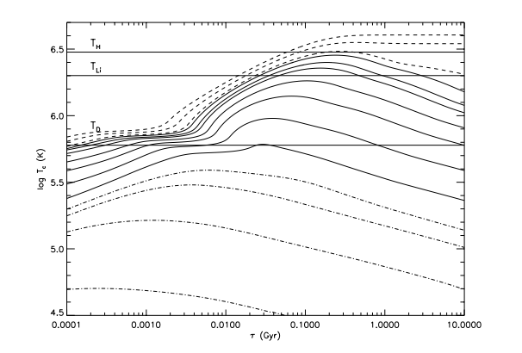
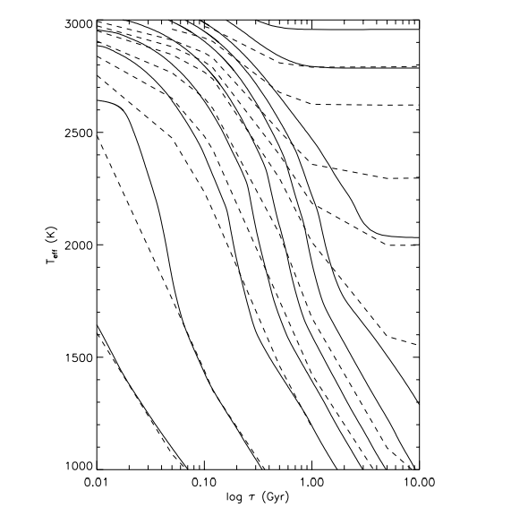
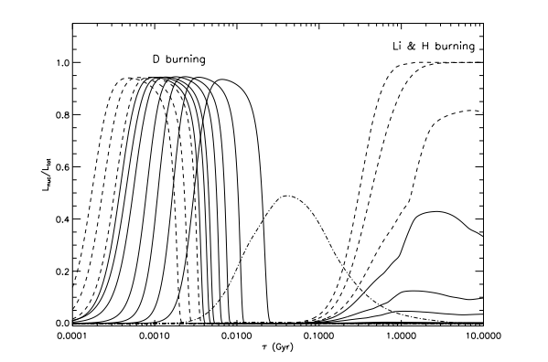
Brown Dwarfs 101
Core Temperature Evolution
Source: Burrows et al. (1997)
Nuclear to Total Luminosity Ratio Evolution
Source: Burrows et al. (1997)
Effective Temperature Evolution
Source: Burrows et al. (1997) & Chabrier et al. (2000a)
Notes:
Effective temperature: temperature of a black body that would emit the same total amount of flux
3 telling plots produced by Burrows et al. (1997) (and Chabier et al. 2000a) describing brown dwarf evolution
Plot 1:
Core temperature evolution for planets, brown dwarfs, and stars
Slight increase in core temperature due to gravitational collapse of cloud.
Temp jumps when deuterium begins fusing
Stars will reach the critical ignition temperature allowing them to sustain a constant temperature while undergoing hydrogen fusion
Brown dwarfs will deplete their deuterium supply then begin to slowly cool down over time.
Plot 2:
Effective temperature evolution (temperature of a blackbody with the same luminosity per surface area as the star)
Brown dwarfs cool over time
Stars will stabilize their effective temperature and not decrease over time
Plot 3:
Nuclear to Total Luminosity Ratio Evolution
Stars and brown dwarfs undergo early deuterium burning (95% of total output luminosity)
Higher mass brown dwarfs don’t begin burning until 1e9-1e10 years and that only accounts for ~40% of total luminosity (rest comes from collapsing cloud)
Studying old objects makes it easier to distinguish brown dwarfs since their properties are much different from stars at these ages

Slide 8
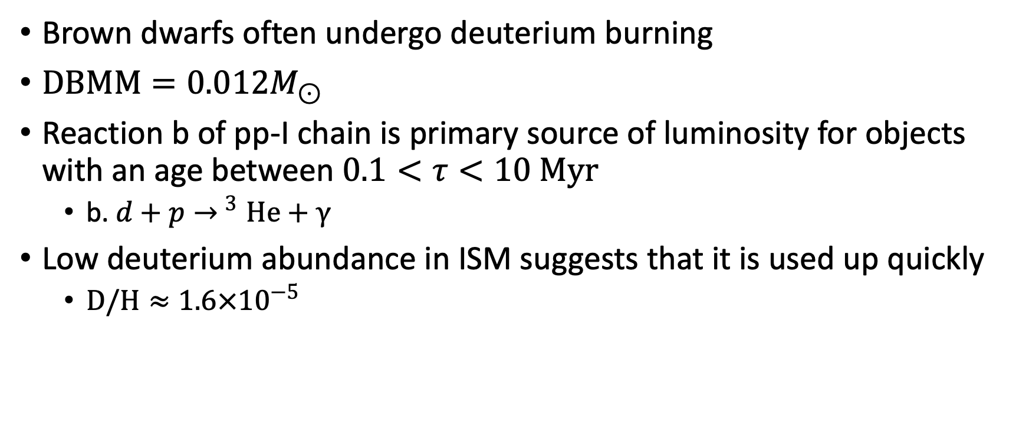
Deuterium Burning
Brown dwarfs often undergo deuterium burning
$DBMM=0.012M_{⊙}$
Reaction b of pp-I chain is primary source of luminosity for objects with an age between $0.1<τ<10 Myr$
b. $d+p{→ }^{3}He+γ$
Low deuterium abundance in ISM suggests that it is used up quickly
$D/H≈{1.6×10}^{−5}$
Notes:
Many brown dwarfs will undergo early deuterium fusion if they are more massive than the DBMM of 0.012M_sun
Critical temperature for deuterium fusion is less (about 1 order of magnitude) than H fusion making it possible in less massive objects.
Most early luminosity comes from deuterium fusion (0.1-10Myr) or the second reaction of the pp1 chain
Used up quickly because of low relative abundance of deuterium

Slide 9
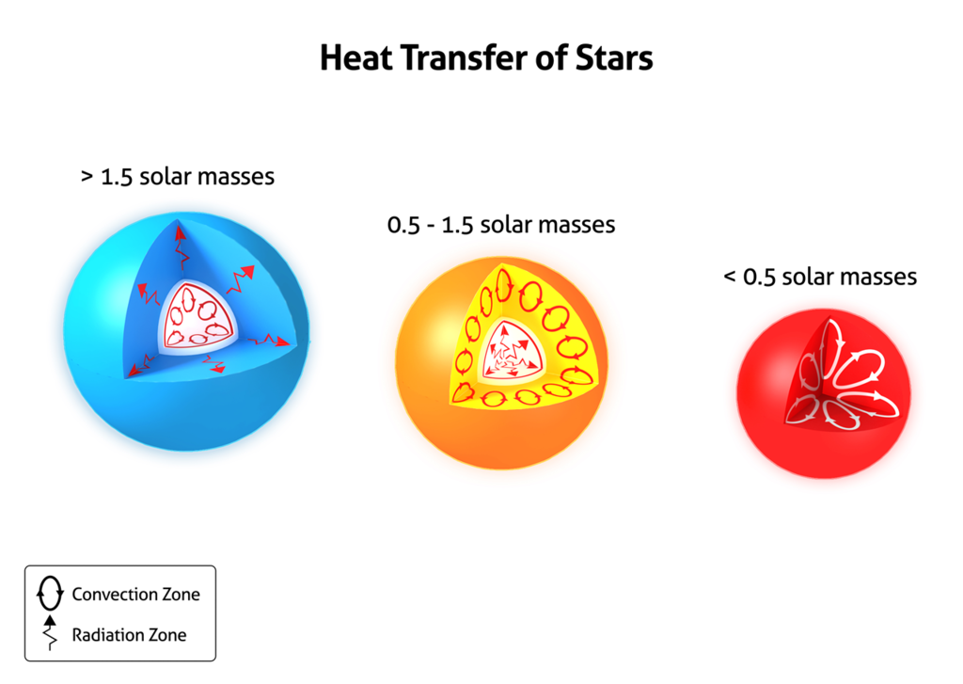
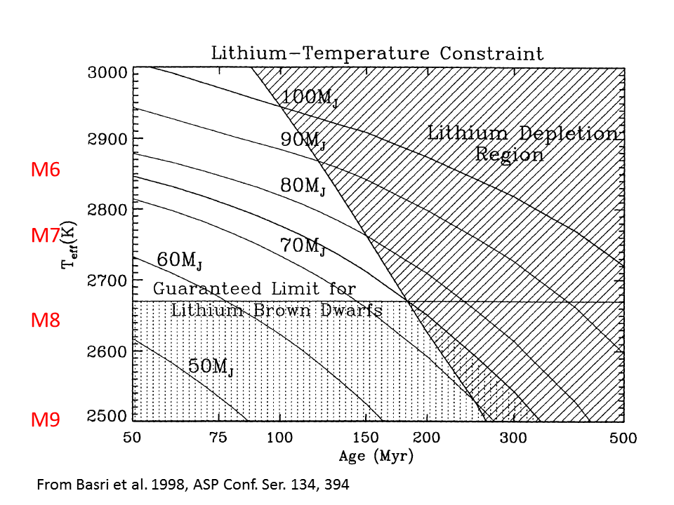
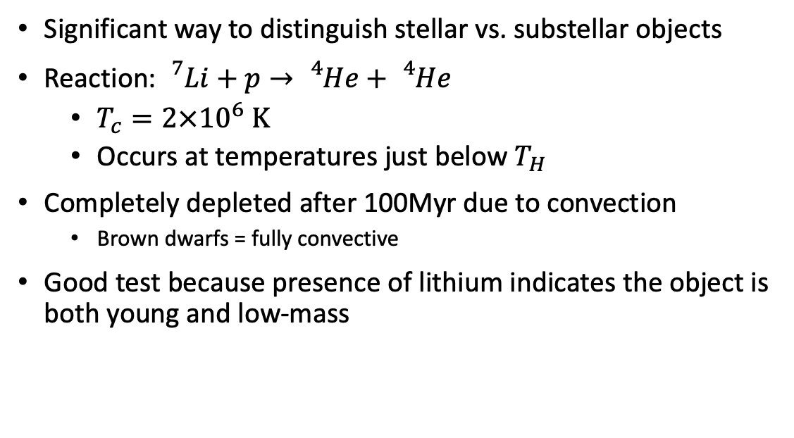
Lithium Test
Significant way to distinguish stellar vs. substellar objects
Reaction: ${}_{}^{7}{Li}+p→{}_{}^{4}{He}+{}_{}^{4}{He}$
$T_{c}=2×{10}^{6} K$
Occurs at temperatures just below $T_{H}$
Completely depleted after 100Myr due to convection
Brown dwarfs = fully convective
Good test because presence of lithium indicates the object is both young and low-mass
Source: AAS Nova
Source: Basri et al. (1998)
Notes:
The presence of lithium fusion is a good indicator for stellar vs. substellar objects
This reaction occurs at a temperature slightly below critical H fusion temperature or with objects of mass M>~0.06M_Sun
Lithium (and deuterium) is completed depleted after ~100Myr due to convection
Density gradient of medium is always greater than density gradient of parcel of material
All brown dwarfs and other objects less massive than roughly 0.5M_sun are fully convective suggesting that all of the present lithium will get cycled through the object and used up
Good test because ensures young and low mass. Stars very quickly use up all helium when hydrogen begins burning.
M6 w/ lithium= brown dwarf or star younger than 140Myr
M6 w/o lithium=star
M8 w/ lithium=brown dwarf younger than 200Myr
M8 w/o lithium=more massive brown dwarf just older than 200Myr or old, low-mass star
Lithium is used up relatively quickly except in objects with low mass and temperature

Slide 10
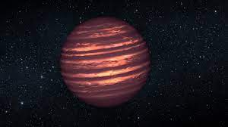
Atmospheres
Effective temperatures between 3000 K-100 K
Pressures between 10 bar – 0.1 bar
Ideal conditions for molecule production
Most abundant molecules:
Cloud formation and rainout below ~2800K
Dust grains
H₂
H₂O
CO
CH₄
N₂
NH₃
H₂S
Metal Oxides (VO, TiO)
Hydrides (FeH, CaH, MgH)
Condensates (Fe, CaTiO₃)
Notes:
The study of brown dwarf atmospheres is a complex and evolving field
The temperature and pressure conditions of brown dwarfs make them ideal for producing complex molecules
CH4=methane
NH3=ammonia
H2S=hydrogen sulfide
Metal oxides, hydrides, and condensates form in brown dwarfs with lower temperatures making cooler objects even more complex to study
Clouds will form below 2800K and can produce exotic rainout (such as iron rain)
Dust grains are also present in the cooler, upper atmospheres of brown dwarfs (typically no larger than 0.1mm)
Dust impacts opacity which is important for studying the evolution of these objects

Slide 11
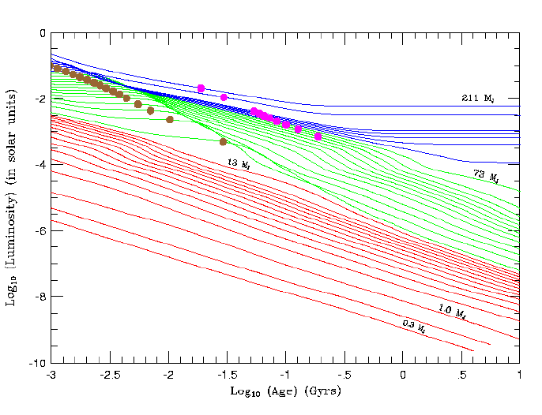
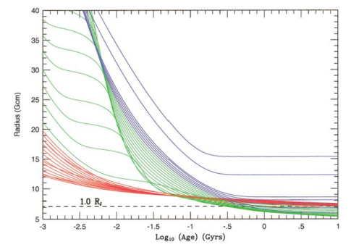
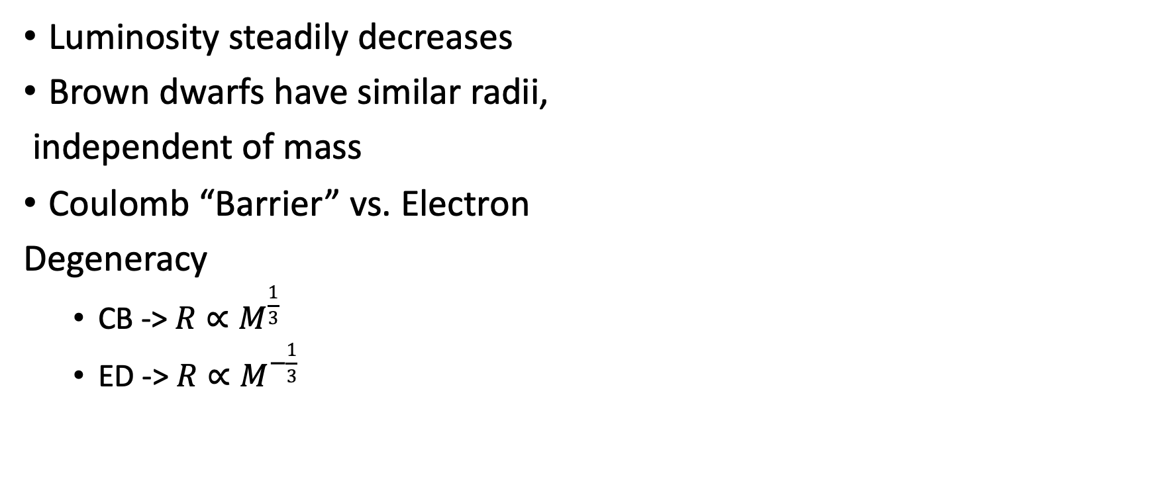
Life & Evolution
Luminosity steadily decreases
Brown dwarfs have similar radii,
independent of mass
Coulomb “Barrier” vs. Electron
Degeneracy
CB -> $R∝M^{\frac{1}{3}}$
ED -> $R∝M^{−\frac{1}{3}}$
Source: Burrows et al. (2001)
Notes:
Due to lack of sustained fusion, luminosity decreases over time for brown dwarfs
Since brown dwarfs are fully degenerate, the mass-radius relationship is destroyed.
Effects of Coulomb Barrier and Electron Degeneracy cancel each other out
Brown dwarfs all have similar radii (approximately +-30-40% the radius of Jupiter) over 1-2 orders of magnitude in mass

Slide 12
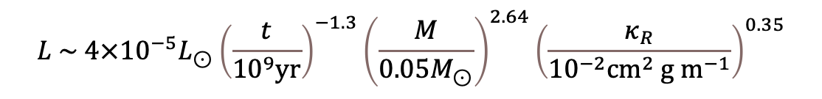
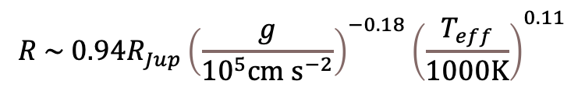
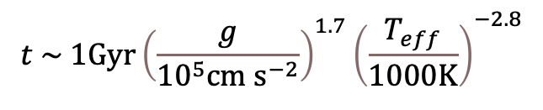
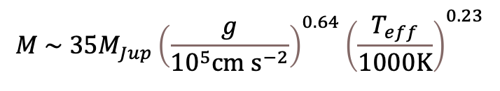
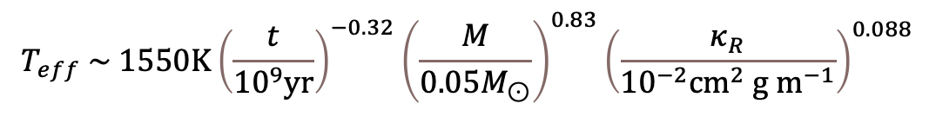
Analytic Evolutionary Equations
Brown dwarfs can be treated as polytropic
Burrows & Liebert (1993), Marley et al. (1996), Burrows et al. (2001), and Auddy et al. (2016) derive analytical expressions describing brown dwarf evolution:
$$L \sim 4×{10}^{−5}L_{⊙}{\left(\frac{t}{{10}^{9}yr}\right)}^{−1.3}{\left(\frac{M}{0.05M_{⊙}}\right)}^{2.64}{\left(\frac{κ_{R}}{{10}^{−2}cm^{2} g{ m}^{−1}}\right)}^{0.35}$$
$$t \sim 1Gyr{\left(\frac{g}{{10}^{5}cm{ s}^{−2}}\right)}^{1.7}{\left(\frac{T_{eff}}{1000K}\right)}^{−2.8}$$
$$T_{eff} \sim 1550K{\left(\frac{t}{{10}^{9}yr}\right)}^{−0.32}{\left(\frac{M}{0.05M_{⊙}}\right)}^{0.83}{\left(\frac{κ_{R}}{{10}^{−2}cm^{2} g{ m}^{−1}}\right)}^{0.088}$$
$$R \sim {0.94R}_{Jup}{\left(\frac{g}{{10}^{5}cm{ s}^{−2}}\right)}^{−0.18}{\left(\frac{T_{eff}}{1000K}\right)}^{0.11}$$
$$M \sim 35M_{Jup}{\left(\frac{g}{{10}^{5}cm{ s}^{−2}}\right)}^{0.64}{\left(\frac{T_{eff}}{1000K}\right)}^{0.23}$$
Notes:
Degenerate interiors imply an equation of state P~rho^(5/3) giving a polytropic index of 1.5 for which R~M^(-1/3)
Since they can be treated as roughly polytropic, analytical expressions have been derived to relate key quantities
g=surface gravity, kappa=opacity
Opacity plays a significant role so it is important to understand the atmospheres which contribute most to opacity

Slide 13
Observational History
Got underway in the early 1980s
3 arenas of brown dwarf searches
Old, visible brown dwarfs
Dynamical brown dwarfs
Young, visible, and “bright” brown dwarfs
Infrared direct imaging surveys (McCarthy et al. 1985)
Radial velocity surveys (Latham et al. 1989)
Young cluster & star formation region surveys (Forrest et al. 1989, Stauffer et al. 1994, Williams et al. 1995)
No confirmed brown dwarfs resulted from these surveys

Slide 14
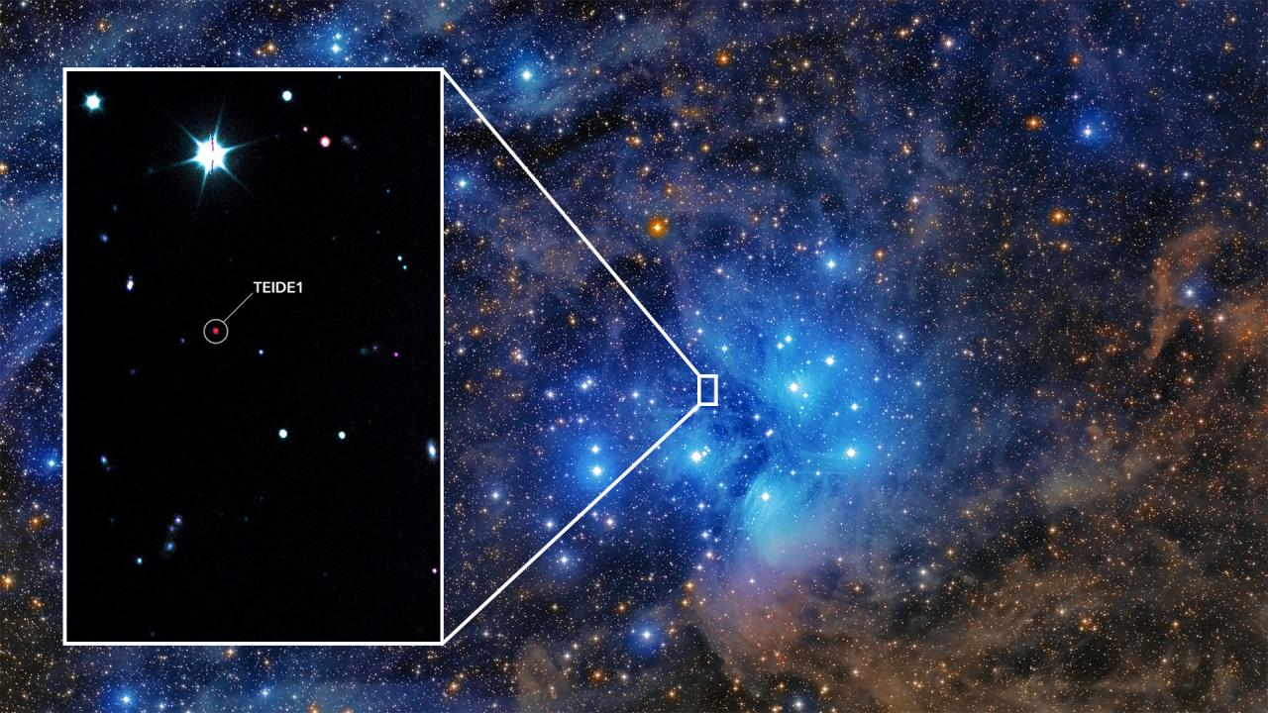
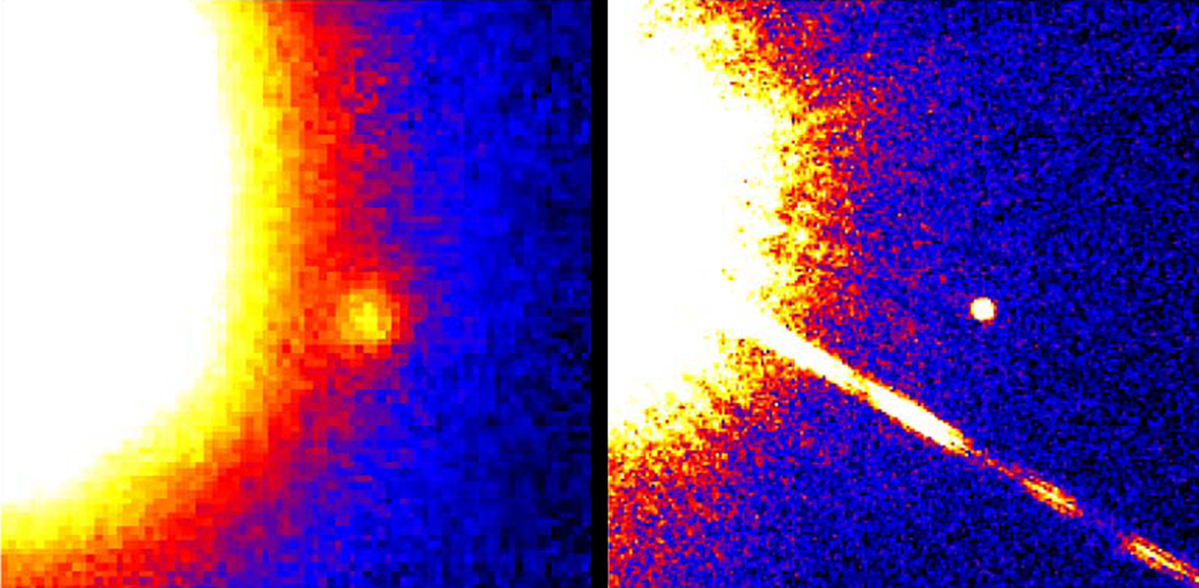
Discovery of First Brown Dwarfs
Investigation of Pleiades by Rebolo et al. (1995) led to discovery of Teide I
Gliese 229B found in low-mass star coronographic survey by Nakajima et al. (1995)
Source: Instituto de Astrofísica de Canarias
Source: Hubble
Notes:
Teide I is an M8 transitionary brown dwarf. It is young and is still burning hydrogen. Degeneracy effects haven’t cooled it below the critical temperature yet.
Gliese 229B is a spectral type Y brown dwarf

Slide 15
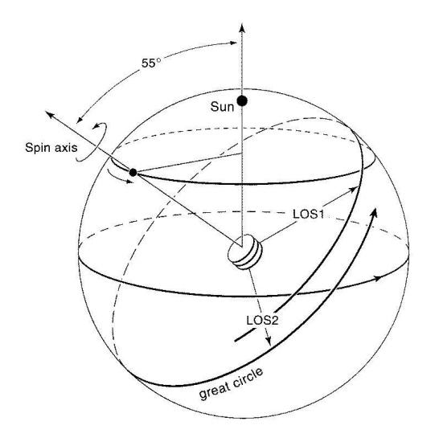
GAIA Mission
Main goal to survey astrometric and photometric properties for over 1 billion sources
Scanning Law
A spin of the satellite about its symmetry axis with T_{rot} = 3 hours
A precession of the satellite spin axis about the Sun-Satellite direction with T_{pr} = 72 days
On average, every region of the sky covered 85 times in 5 years
Reconstruction of parallaxes and proper motions
Detection of photometric and spectroscopic variability
High accuracy measurements at end of mission lifetime
Notes:
Jumping ahead about 2 decades we come to the GAIA mission, the mission of interest for this thesis
Goal is to survey the sky using astrometry and photometry

Slide 16
GAIA Mission
Launched in 2009
Sitting at Earth’s L2 point
3 three-mirror telescopes
Astrometric telescope, photometric, and spectrometric telescope
CCDs sensitive to G-band (250-1050 nm)
Optical telescope

Slide 17
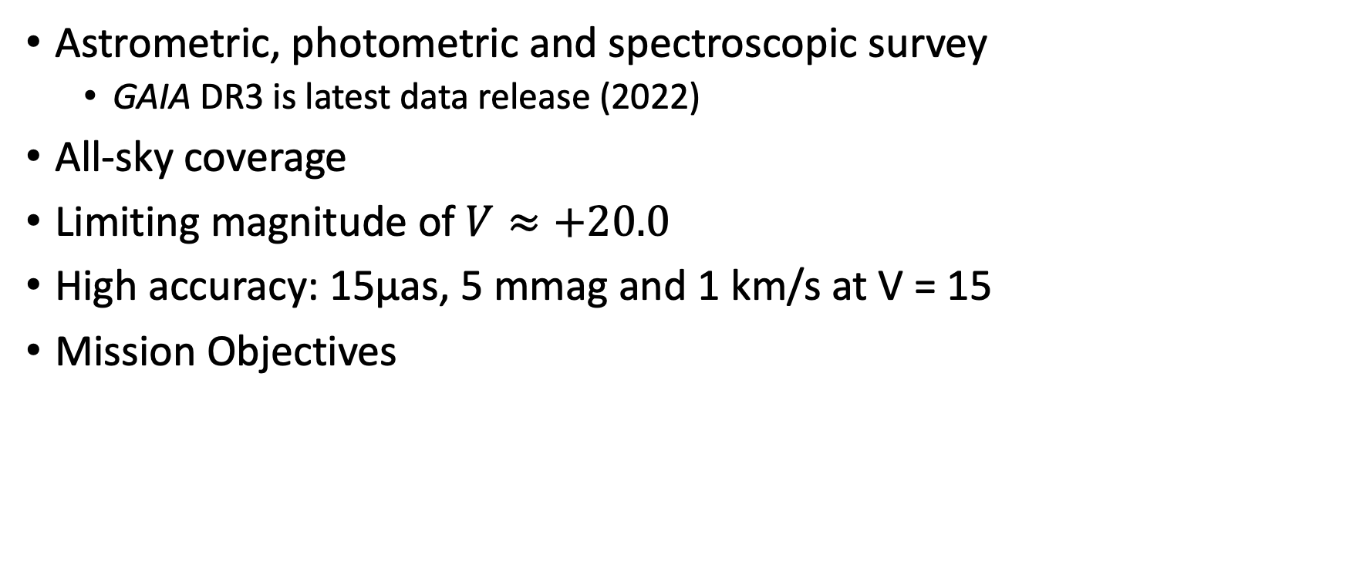
GAIA Performance
Astrometric, photometric and spectroscopic survey
GAIA DR3 is latest data release (2022)
All-sky coverage
Limiting magnitude of $V≈+20.0$
High accuracy: 15μas, 5 mmag and 1 km/s at V = 15
Mission Objectives
Galactic Astrophysics
Stellar Astrophysics
Distance Scale
Solar System
Fundamental Physics
Local Group
Supernovae
Quasars
Exo-planets

Slide 18
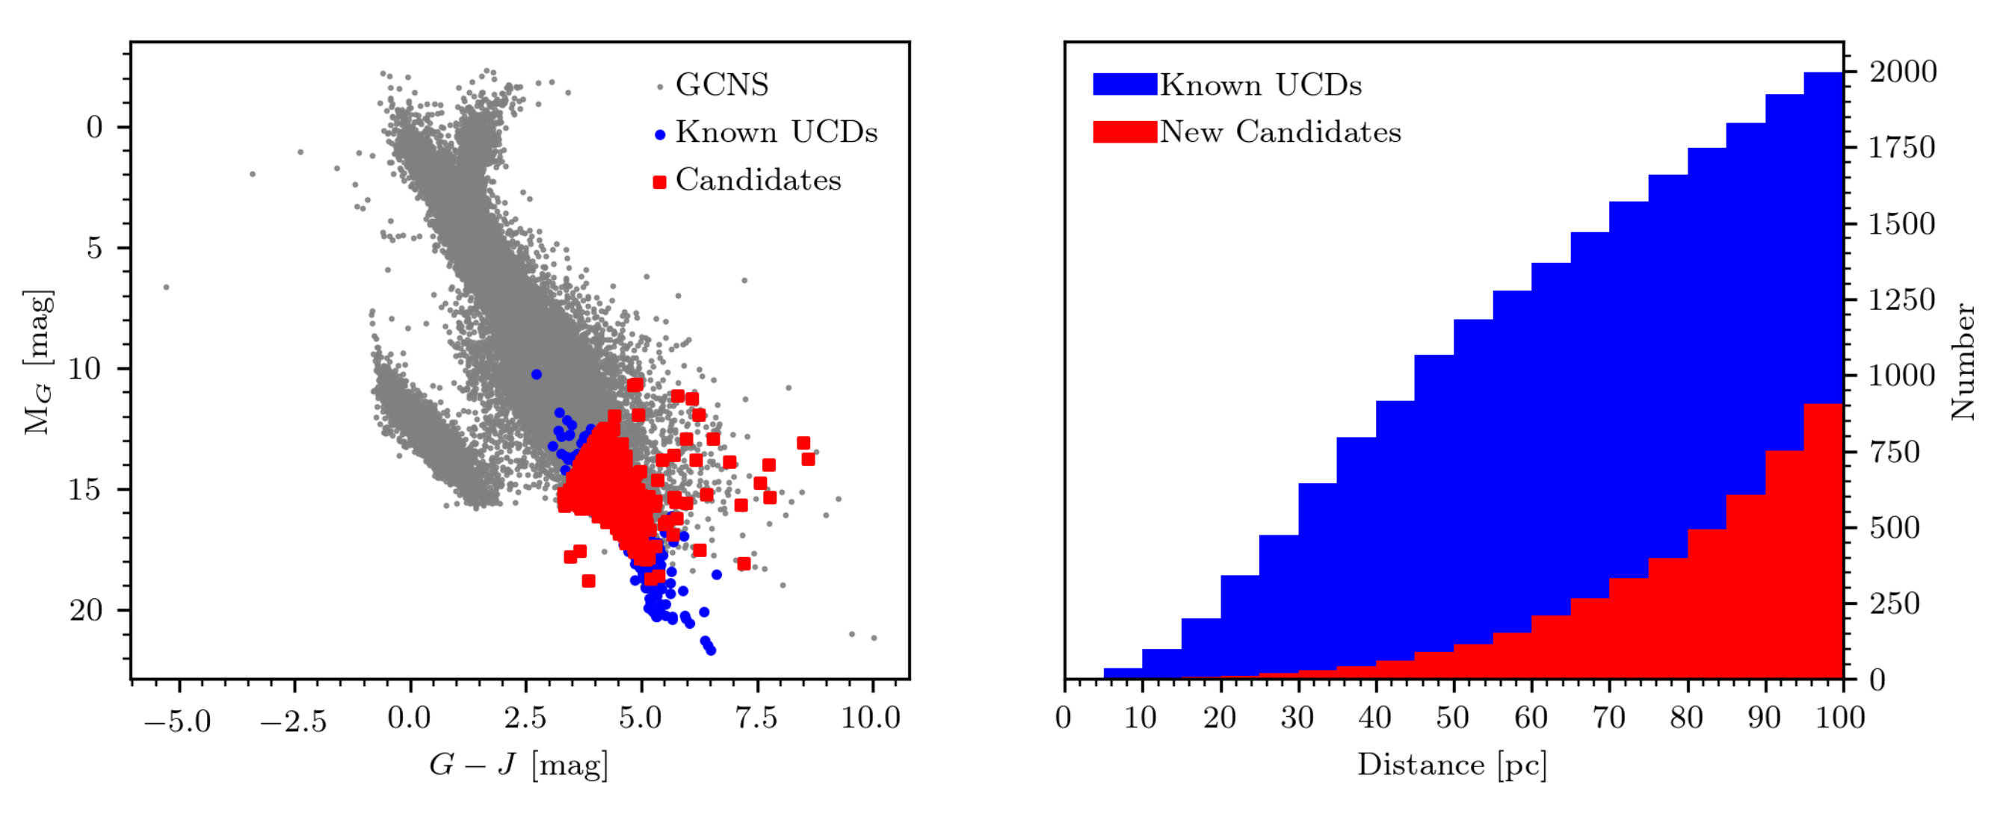
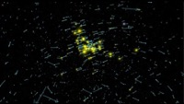
GAIA EDR3 and the GCNS Sample
Detailed census of stars in solar neighborhood within 100pc
Positions
Motions
Binary Systems
Local star clusters
Many ultracool dwarfs (UCDs) detected
Optimal for studying cool and dim objects
Source: GAIA Collaboration, R. Smart, et al. A&A 2020
Source: ESA
Notes:
Video details:
Zooms out to get 3D picture of 100pc sample
Can investigate motions of sources (proper motion)
Can resolve and inspect binary systems
Also can investigate nearby star clusters

Slide 19
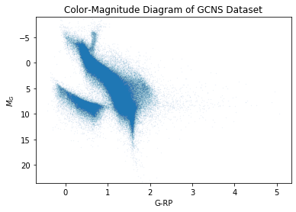
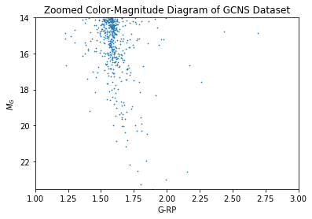
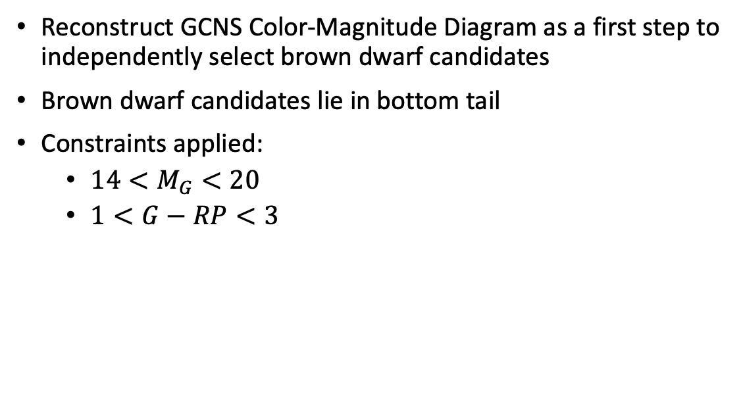
Color—Magnitude Diagrams
Reconstruct GCNS Color-Magnitude Diagram as a first step to independently select brown dwarf candidates
Brown dwarf candidates lie in bottom tail
Constraints applied:
$14<M_{G}<20$
$1<G−RP<3$
Notes:
Our goal here is to use GCNS to select out the brown dwarf candidates by creating a luminosity function

Slide 20
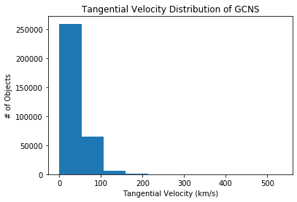
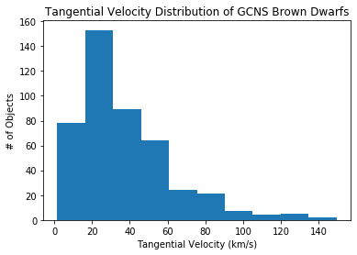
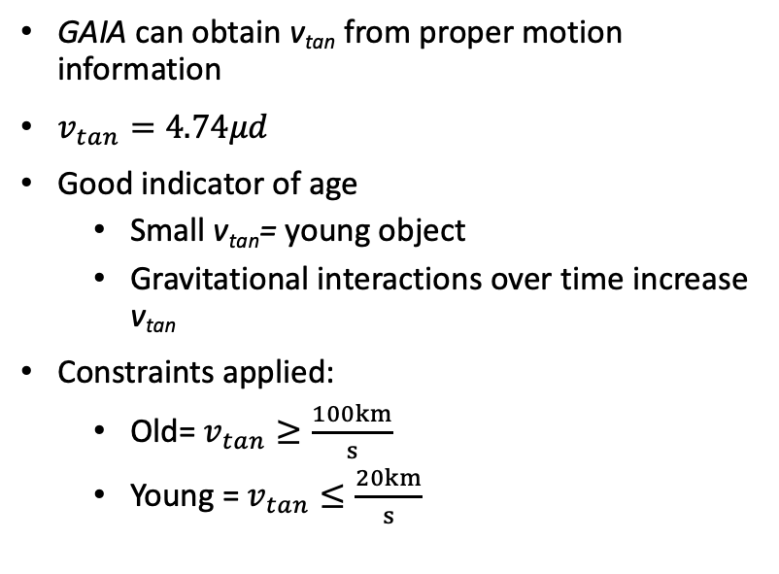
Tangential Velocity (v_{tan})
GAIA can obtain v_{tan} from proper motion information
$v_{tan}=4.74μd$
Good indicator of age
Small v_{tan}= young object
Gravitational interactions over time increase v_{tan}
Constraints applied:
Old= $v_{tan}≥\frac{100km}{s}$
Young = $v_{tan}≤\frac{20km}{s}$
Notes:
Tangential velocity allows for the age of objects to be determined.
Looking at previous evolutionary models, it would probably be more helpful to look at old objects since their properties differ significantly from young brown dwarfs and low-mass stars
GAIA is capable of detecting cooler, dimmer objects that are generally older in age
First plot is who GCNS sample
Second plot has color and magnitude constraints applied

Slide 21
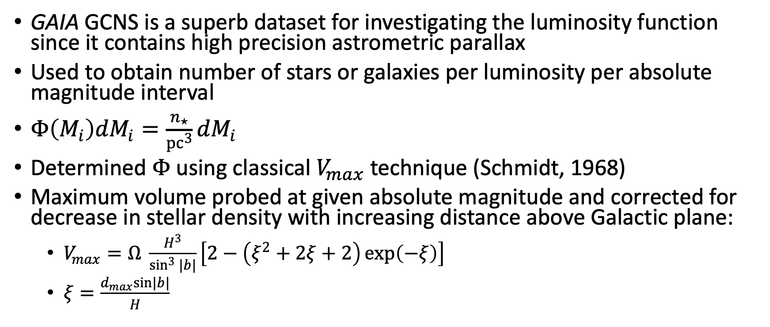
The Luminosity Function
GAIA GCNS is a superb dataset for investigating the luminosity function since it contains high precision astrometric parallax
Used to obtain number of stars or galaxies per luminosity per absolute magnitude interval
$Φ\left(M_{i}\right){dM}_{i}=\frac{n_{⋆}}{{pc}^{3}}{dM}_{i}$
Determined $Φ$ using classical $V_{max}$ technique (Schmidt, 1968)
Maximum volume probed at given absolute magnitude and corrected for decrease in stellar density with increasing distance above Galactic plane:
$V_{max}=Ω \frac{H^{3}}{\sin^{3}{|b|}}\left[2−\left(ξ^{2}+2ξ+2\right)\exp\left(−ξ\right)\right]$
$ξ=\frac{d_{max}sin|b|}{H}$
Notes:
Omega=area of sky (4pi)
H=365pc (thin disk scale height for galaxy)
b= galactic latitude
dmax= maximum distance of detection for object of given brightness (estimated between 0-100pc for each object)

Slide 22
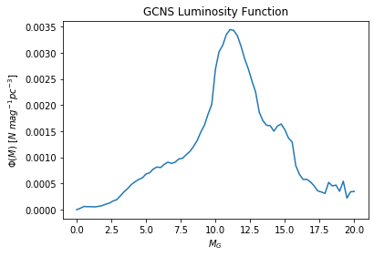
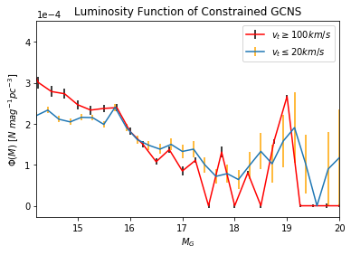
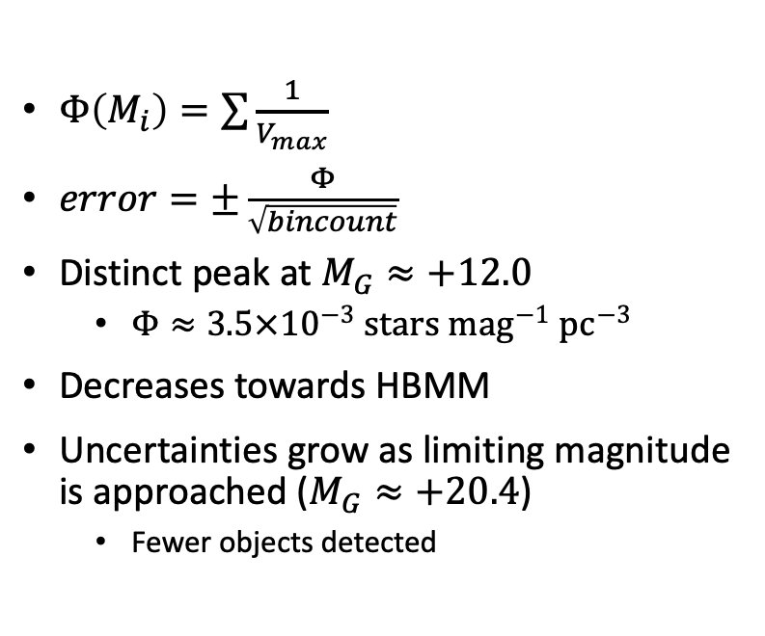
GAIA Luminosity Function
$Φ\left(M_{i}\right)=\sum{\frac{1}{V_{max}}}$
$error=±\frac{Φ}{\sqrt{bincount}}$
Distinct peak at $M_{G}≈+12.0$
$Φ≈3.5×{10}^{−3} stars {mag}^{−1} {pc}^{−3}$
Decreases towards HBMM
Uncertainties grow as limiting magnitude is approached ($M_{G}≈+20.4$)
Fewer objects detected
Notes:
Luminosity function is sum over all objects within a given absolute magnitude bin
Error by finding luminosity function over sqrt of the number of objects within each bin
Plot 2 normalized to Mg=+15

Slide 23
Theoretical Brown Dwarf Models
Useful to compare observations to models to better contextualize the GAIA results
Sonora Models from Marley et al. (2021)
CLES Models from Fernandes et al. (2019)
Models from Filippazzo et al. (2015)

Slide 24
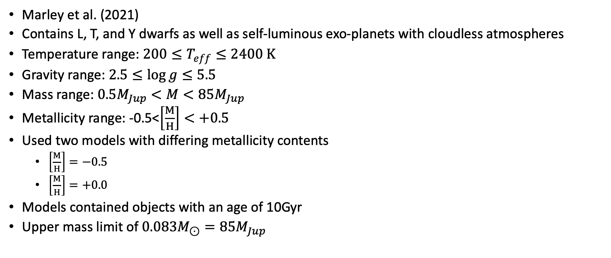
Sonora Substellar Models
Marley et al. (2021)
Contains L, T, and Y dwarfs as well as self-luminous exo-planets with cloudless atmospheres
Temperature range: $200≤T_{eff}≤2400 K$
Gravity range: $2.5≤\log{g≤5.5}$
Mass range: $0.5M_{Jup}<M<85M_{Jup}$
Metallicity range: -0.5<$\left[\frac{M}{H}\right]<+0.5$
Used two models with differing metallicity contents
$\left[\frac{M}{H}\right]=−0.5$
$\left[\frac{M}{H}\right]=+0.0$
Models contained objects with an age of 10Gyr
Upper mass limit of $0.083M_{⊙}=85M_{Jup}$

Slide 25
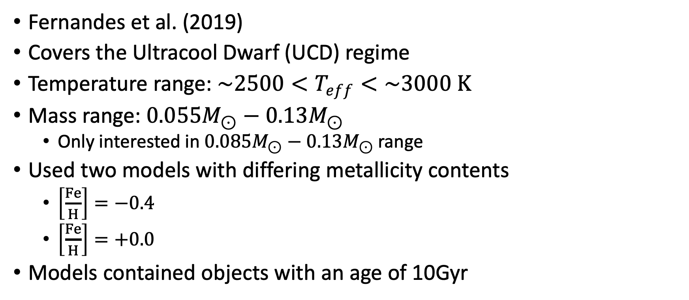
CLES Stellar Models
Fernandes et al. (2019)
Covers the Ultracool Dwarf (UCD) regime
Temperature range: $\sim 2500<T_{eff}<\sim 3000 K$
Mass range: $0.055M_{⊙}−0.13M_{⊙}$
Only interested in $0.085M_{⊙}−0.13M_{⊙}$ range
Used two models with differing metallicity contents
$\left[\frac{Fe}{H}\right]=−0.4$
$\left[\frac{Fe}{H}\right]=+0.0$
Models contained objects with an age of 10Gyr

Slide 26
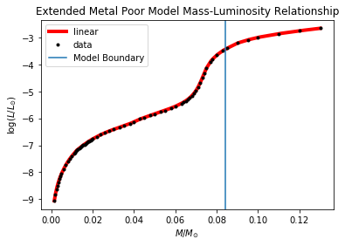
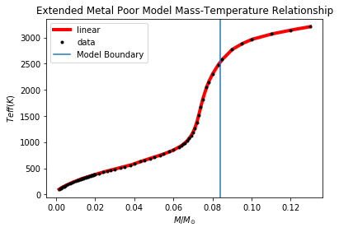
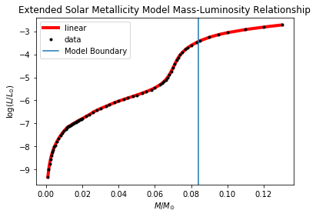
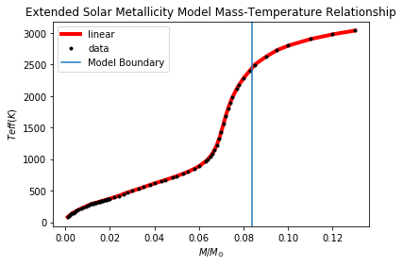
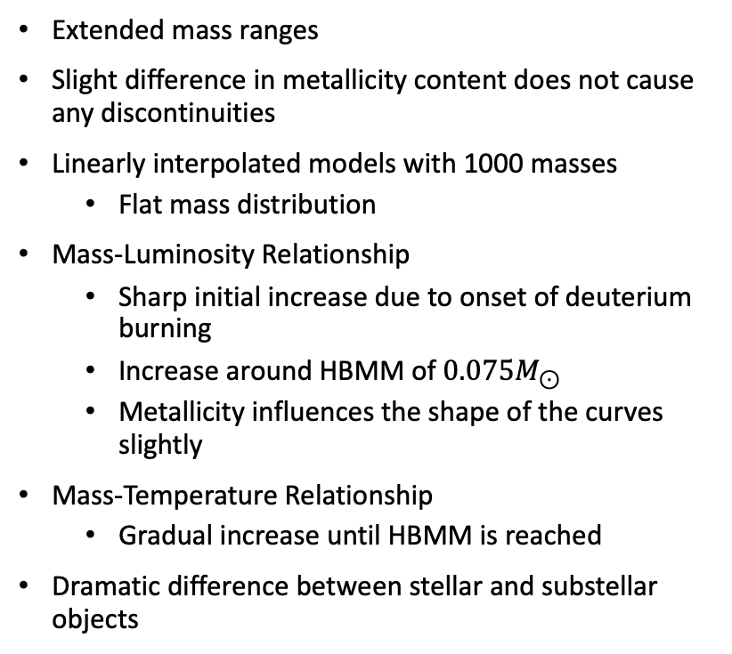
Combining the Models
Extended mass ranges
Slight difference in metallicity content does not cause any discontinuities
Linearly interpolated models with 1000 masses
Flat mass distribution
Mass-Luminosity Relationship
Sharp initial increase due to onset of deuterium burning
Increase around HBMM of $0.075M_{⊙}$
Metallicity influences the shape of the curves slightly
Mass-Temperature Relationship
Gradual increase until HBMM is reached
Dramatic difference between stellar and substellar objects

Slide 27
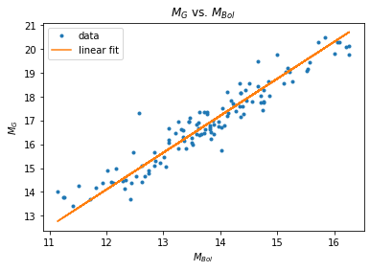
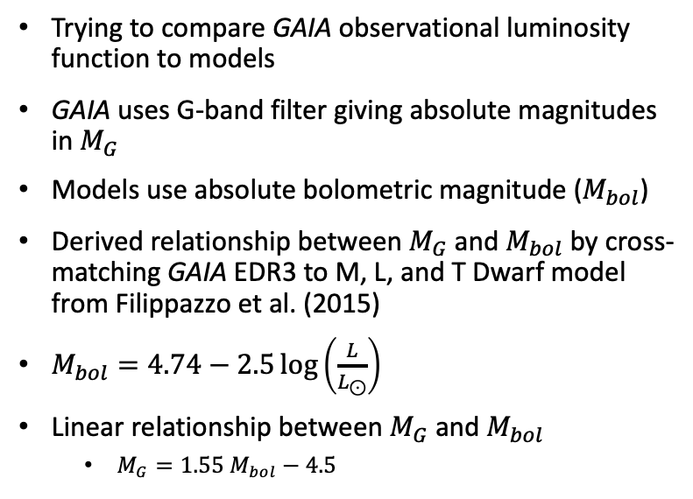
Absolute Magnitude Relationship
Trying to compare GAIA observational luminosity function to models
GAIA uses G-band filter giving absolute magnitudes in $M_{G}$
Models use absolute bolometric magnitude ($M_{bol}$)
Derived relationship between $M_{G}$and $M_{bol}$by cross-matching GAIA EDR3 to M, L, and T Dwarf model from Filippazzo et al. (2015)
$M_{bol}=4.74−2.5\log\left(\frac{L}{L_{⊙}}\right)$
Linear relationship between $M_{G}$ and $M_{bol}$
$M_{G}=1.55 M_{bol}−4.5$
Notes:
Bolometric magnitude: measure of the total radiation of a star emitted across all wavelengths

Slide 28


Normalization
Before comparing observations to models, they need to be normalized to each other
Models yield number of stars per absolute magnitude interval
$V_{max}$ analysis yields number of stars per luminosity per absolute magnitude interval
Initial check suggests that GAIA data is about 6 orders of magnitude smaller
Performed a Reduced Chi Square Test between observational distribution and model distributions to find minimum statistical normalization value
Reduced Chi Square Test yields a normalization constant of 925,000

Slide 29



GAIA-Model Comparison
Upon normalizing, we can finally compare our observational luminosity function to the models
Used luminosity function for old objects with high $v_{tan}$ to increase likelihood of object being a brown dwarf
Constrained GCNS sample is, predominately low mass stars with some potential high mass brown dwarfs
Uncertainties are large in brown dwarf regime
Metallicity slightly adjusts the location of HBMM
Metal-poor model has metallicity of $0.08M_{⊙}$
Solar metallicity model has metallicity of $0.078M_{⊙}$
GAIA is good for investigating stars/brown dwarfs straddling HBMM
Barely scrapes the surface of brown dwarf regime
Notes:
While it is good for investigating late M type stars and some L type brown dwarfs, GAIA is not the best too for investigating the T and Y dwarf regime since it simply cannot see objects that are so dim.

Slide 30

Conclusions
Brown dwarfs and stars undergo similar formation, but brown dwarfs do not have enough mass to start hydrogen fusion
Brown dwarfs can fuse deuterium and lithium in their early lives but ultimately use up their supply and begin to cool and dim
Many brown dwarfs are cool enough to have complex molecular atmospheres
First bona fide brown dwarfs discovered in 1995
GAIA’s large astrometric databases make it perfect for investigating low mass stars and potential brown dwarfs
Applying magnitude, color, and velocity constraints and using the $V_{max}$technique yield a steadily decreasing luminosity function for both young and old brown dwarf candidates
Comparison to models suggests that most objects in our sample are late M-type stars
Metallicity is important when surveying objects immediately surrounding the HBMM
GAIA is a great tool for investigating the region surrounding the HBMM but future missions such as JWST and the Nancy Grace Roman Space Telescope, which will search the sky in the infrared, may yield more promising candidates

Slide 31
THANK YOU

Slide 32
QUESTIONS?

